Slide 1

Welcome to Zariba Academy
Overview Lecture
academy.zariba.com

Slide 2
Lecture Content
About Zariba
Zariba Academy

Slide 3
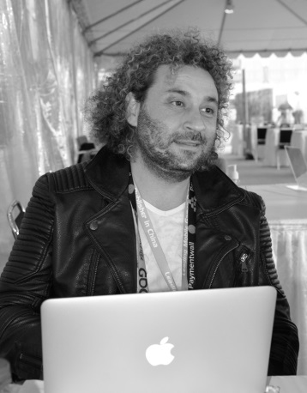
About Zariba
Zariba was founded in 2007.
Radostin Petrov is a serial entrepreneur and Founder of a great number of companies.
Мore than 20 years of investment and project management experience in the IT field, such as: Pi Consult Ltd, Podaraci.bg, Ocean solutions Ltd, among others.
Since 2007 Radostin has established various businesses – Waphoo, App Chef, Casualino, Zariba Games, Fractal Games, Virtual Amigos among others.
He receives ~1000 emails a day and reads them all.

Slide 4

About Zariba
Zariba is an international company with divisions in USA, Spain, Bulgaria and Philippines.
At present, Zariba has more than 50 employees and plans to expand further.
Founded in 2007, Zariba has released many games on a multitude of mobile platforms, utilizing a wide range of technologies.
Links:
Mobile Games
Belotbg

Slide 5

About Zariba
Zariba is home for many game studios

Slide 6
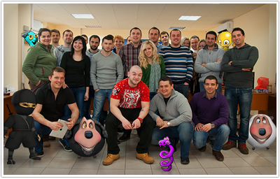
About Zariba
We are one happy family :)

Slide 7
Zariba Academy
It is free!
You have the unique opportunity to become a game developer in just about 6 months, but:
You have to work hard!
You have to do your homework!
You have to participate in team projects!
You have to ace your exams!

Slide 8

Zariba Academy
Our first course is:

Slide 9
Zariba Academy
Let’s get started!

Slide 10
Zariba Academy
But first…

Slide 11



Zariba Academy
Questions

